Slide 1










Shift Registers and Memories
LAURINE OWINO (LAMOY)

Slide 2
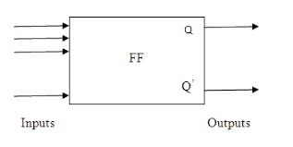
Flip-Flops
Basic memory elements capable of storing one bit in a digital system.
Types:
D flip-flop
R-s flip-flop
J-K flip-flop
T flip-flop

Slide 3
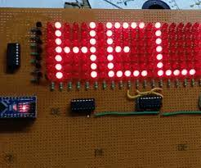
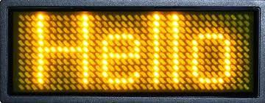

Slide 4





Digital device for data storage and and transfer - data is entered then shifted out
Shift Registers
Links between main digital system and I/O channels
Constructed by flip-flops. Number of flip-flops defines the size of the register

Slide 5
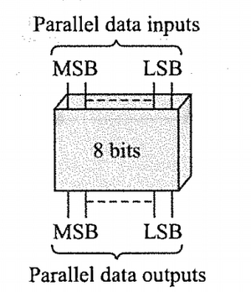
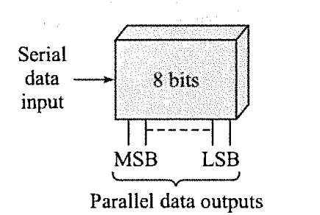
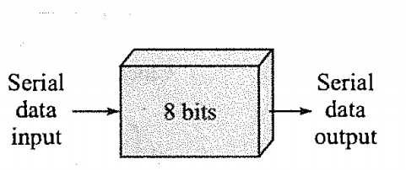
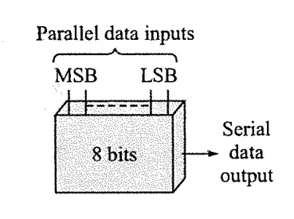
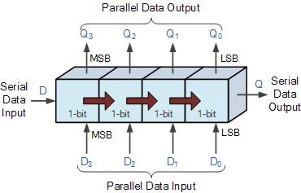
Types of Shift Registers
SERIAL IN SERIAL OUT
PARALLEL IN PARALLEL OUT
SERIAL IN PARALLEL OUT
PARALLEL IN SERIAL OUT
SERIAL IN PARALLEL OUT
UNIVERSAL

Slide 6








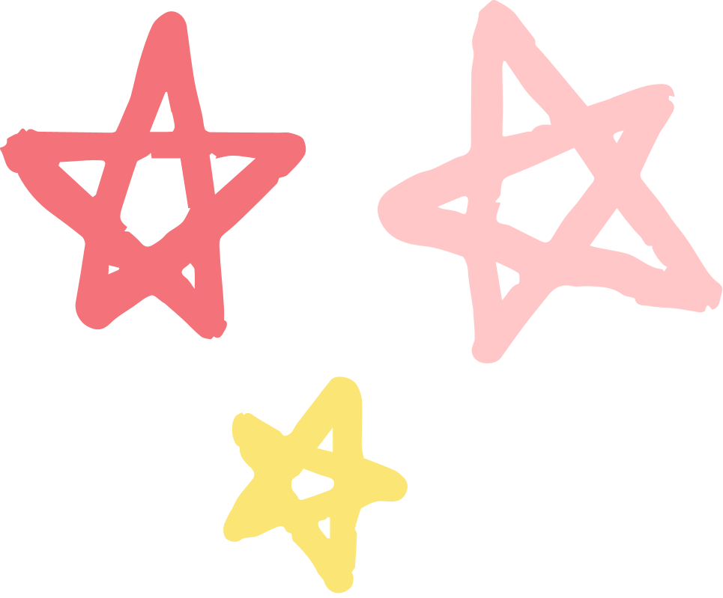


Semi-conductor Memories
Larger systems use SC chips which are made of an array of memory cells.
Made of flip-flops which are Bipolar, MOS, CMOS.
Two types:
RAM
ROM
Can be used to store programmed instructions and data.

Slide 7

RAM
R0M
Volatile
Temporary storage of programs
Types:
SRAM
DRAM
Not volatile
Used to store data that is not to change e.g startup programs
Types:
Mask Programmed RO
PROM
EPROM
EEPROM

Slide 8



Memory in Arduino
FLASH MEMORY
SRAM
EEPROM
Stores arduino sketch; program image and any initialized data.
ATMega 128-32k
ATMega 2560-256k
Where sketch creates and manipulates variables.
Is made of 3 parts: static data, heap, stack.
Where you can store long-term data.
ATMega 128-1k
ATMega 2560-4k
ATMega 128-2k
ATMega 2560-8k

Slide 9






Optimizing Memory
SHIFT DATA OR CALCULATIONS TO COMPUTER
STORE DATA THAT YOU WON'T MODIFY IN FLASH
F() STRINGS
Arduino will store them in PROGMEM
Use PROGMEM
If sketch talks to program on computer.
USE SMALLER DATA SETS
REMOVE UNUSED VARIABLES
RESERVE() STRINGS
If you are using arrays, large data sets.
Avoid realloc().
Variables occupy space

Slide 10
Optimizing Memory (continued)
VARIABLE ALLOCATION
REMOVE DEAD CODE
REMOVE BOOTLOADER
Go local.
Avoid dynamic allocation
Unused libaries, functions and variables.
Last option!
You'll require ISP programmer.
CONSOLIDATE REPEATED CODE
Make it a function!!

Slide 11

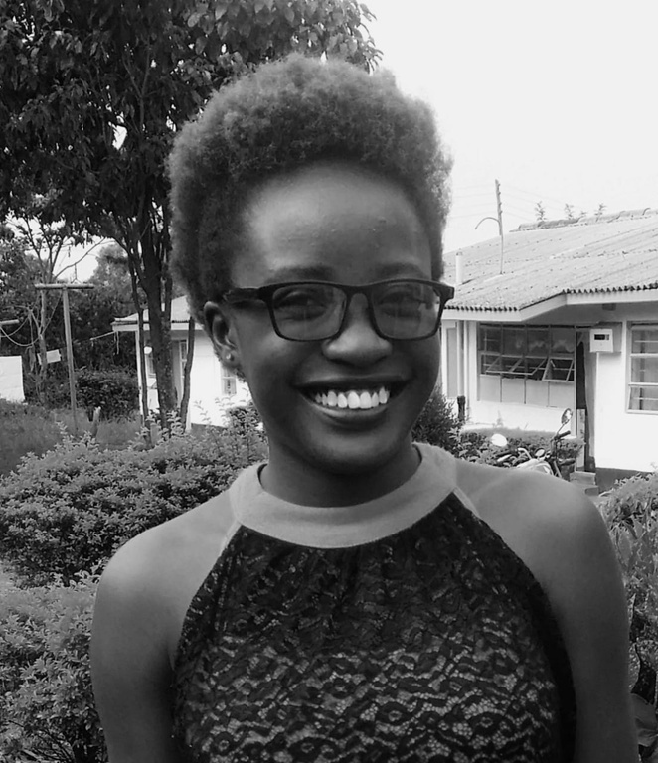


Laurine Owino (Lamoy)
Electrical and Electronics Engineering Student, 5th year.
Cyber-security and hardware/firmware enthusiast

